Slide 1
Correlation & Regression
Association between quantitative variables

Slide 2
Association
Suppose we wanted to see if two variables (e.g., height and weight) were related to one another
How can we measure the strength of the relationship between the two variables?
How can we model the relationship between the variables?

Slide 3
Association
To see if two variables are related, we can do so graphically and analytically
Scatterplot – a graph on which the pairs of data are plotted, with each pair representing a point

Slide 4
Scatterplot of cigs/day vs. CO level
Outlier?
Outlier?

Slide 5
Correlation
Correlation
A correlation exists between two variables when they are related
Pearson
Spearman
Kendall

Slide 6
Correlation
Linear Correlation Coefficient (Pearson)
Measures the strength of the linear relationship between two variables
Assumptions
Paired data are a simple random sample
the (x,y) pairs of data come from a bivariate normal distribution

Slide 7
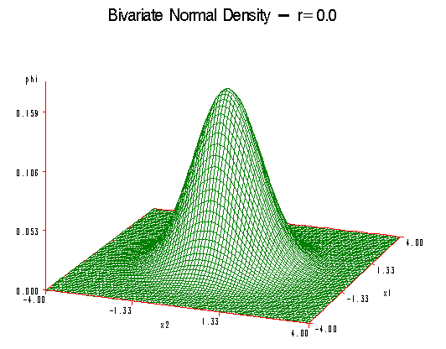
Correlation
http://www.stat.psu.edu/online/courses/stat505/05_multnorm/graphics/r_0.0.gif

Slide 8
Correlation

Slide 9
Regression
Regression model
Describes how the population of each conditional distribution for the dependent variable depends on the independent variable
Independent (predictor/explanatory) variable
Dependent (response) variable

Slide 10
Regression
Regression model
Regression equation

Slide 11
Regression

Slide 12
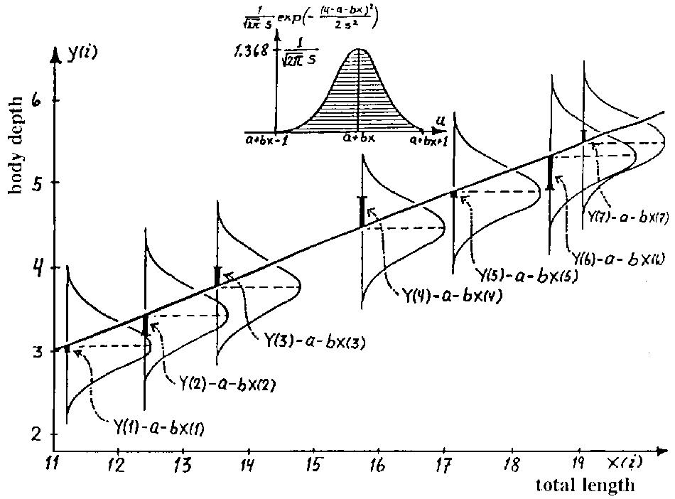
Regression

Slide 13
Regression
Estimating slope and intercept

Slide 14
Slope
Intercept

Slide 15
Test of Significance
Relationship between slope and correlation:

Slide 16
Correlation and Regression
Hypothesis test
Is the correlation different from zero?
Is the slope different from zero?
H₀: ρ = 0 or β₁ = 0
H₁: ρ ≠ 0 or β₁ ≠ 0

Slide 17
Correlation and Regression
Test Stat
Follows a t-distribution with n-2 dof.

Slide 18
Correlation and Regression
Interpret the slope
For every 1 unit change in x, y increases/decreases by ____ units
Coefficient of determination
r²
The amount of variation in y that is explained by x

Slide 19
Correlation and Regression
Outliers may effect estimates of regression coefficients
-1 < r < 1
Correlation does not imply causality
Non-linear relationships may exist
If the slope is not significant, then the best predicted value for every y is the mean of the dependent variable

